Slide 1






< Please use one of these logos >
(Just copy and paste into your poster; or save as Picture, and import)
(black background is only to show
logo with white lettering)
Text boxes and graphics need to be ½ inch or more away from the edge. The pink borders on the Powerpoint template are there to serve as a guide.
Use the little handles to adjust size of graphics and text boxes:
-- corner handles to retain proportion,
-- center handles to stretch
This is an example of a text box that extends into the ½ inch “danger zone”. Why danger? Because it will get lopped off by the printer! ☹ Don’t go by where the text or graphic begins/ends – Select All, so all text box and graphic borders show up, and adjust accordingly.
My Colorful Poster
Me, Myself, and I
School of Kinesiology
U-M color specifications:
Maize:
PMS: 7406
CMYK: 0/18/100/0
RGB: 252, 203, 0
Hex: ffcb05
Blue:
PMS: 282
CMYK: 100/60/0/60
RGB: 0/46/90
Hex: 00274c
Choose your blues carefully. What you see onscreen and how it prints out may be two different things!
Choose your blues carefully. What you see onscreen and how it prints out may be two different things!
Choose your blues carefully. What you see onscreen and how it prints out may be two different things!
Choose your blues carefully. What you see onscreen and how it prints out may be two different things!
Choose your blues carefully. What you see onscreen and how it prints out may be two different things!
Choose your blues carefully. What you see onscreen and how it prints out may be two different things!
Choose your blues carefully. What you see onscreen and how it prints out may be two different things!
Choose your blues carefully. What you see onscreen and how it prints out may be two different things!
Choose your blues carefully. What you see onscreen and how it prints out may be two different things!
Choose your blues carefully. What you see onscreen and how it prints out may be two different things!
Choose your blues carefully. What you see onscreen and how it prints out may be two different things!
Choose your blues carefully. What you see onscreen and how it prints out may be two different things!
PLEASE don’t go hog-wild on color – such as this groovy background. Ink is expensive, and saturated color tends to bloat file size. Please do not use a solid blue background, either, unless you have white text boxes to cut down on the blue ink required.
We reserve the right to alter your artistic vision… 😐

Slide 2
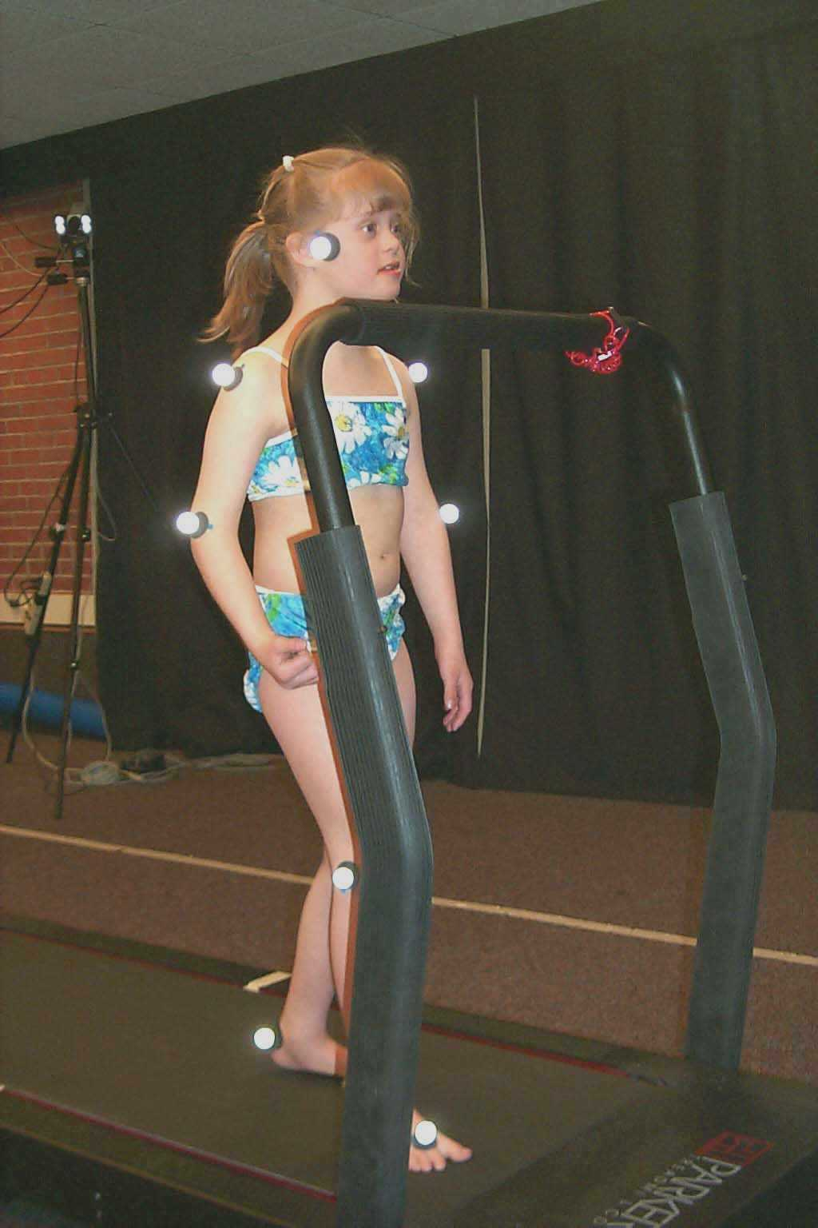
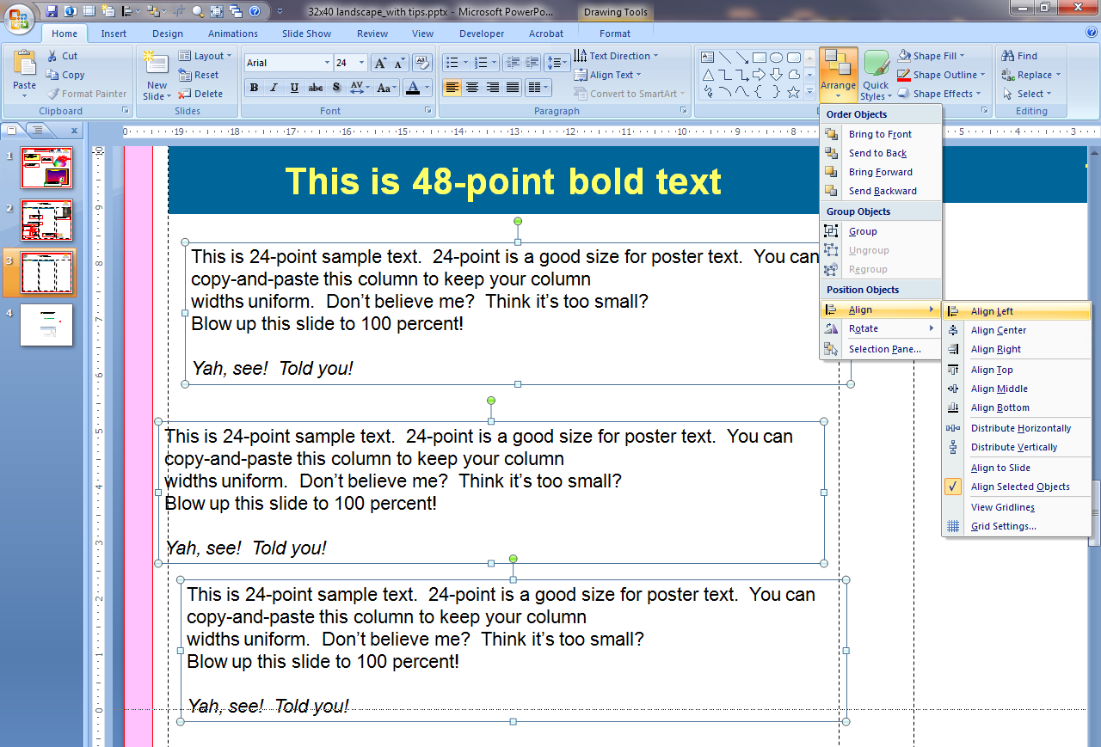
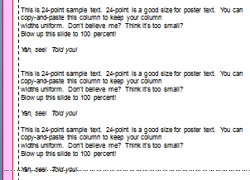
This is 72-point bold sample text
To make your text columns even, draw a rectangle and use it as a guide: copy it and adjust your other columns of text to conform.
You can even use the box as a neat-o graphic enhancement to your poster!
This is 44-point bold sample text
This is 44-point un-bold sample text
This is 48-point bold text
This is 36-point bold text
This is 24-point sample text. 24-point is a good size for poster text. You can copy-and-paste this column to keep your column
widths uniform. Don’t believe me? Think it’s too small?
Blow up this slide to 100 percent!
Yah, see! Told you!
This is 24-point sample text. 24-point is a good size for poster text. You can copy-and-paste this column to keep your column widths uniform. Don’t believe me? Think it’s too small? Blow up this slide to 100 percent!
Larger than 24-point is fine, too.
Please dial down photo resolution to 150dpi or lower when you can. To see what it will look like as a finished poster, adjust your view of the slide to 100%, and see how it looks.
Graphics, like charts, may need to be higher resolution to look good.
This is 24-point sample text. 24-point is a good size for poster text. You can copy-and-paste this column to keep your column
widths uniform. Don’t believe me? Think it’s too small?
Blow up this slide to 100 percent!
Yah, see! Told you!
Too many intersecting elements.
Adjust text boxes so they don’t overlap graphic;
Crop any excess white space from graphics.
HYPOTHESES
1. Children with DS will have lower levels of stiffness than children with typical development (TD) during walking.
2. Children with DS will produce less muscle force than children with TD during walking.
3. Children with DS will have more difficulty adapting stiffness and forcing when speed is manipulated.
This is 24-point sample text. 24-point is a good size for poster text. You can copy-and-paste this column to keep your column widths uniform. Don’t believe me? Think it’s too small? Blow up this slide to 100 percent!
How to align text boxes (graphics, etc.)
Select each item you want to align by holding the Shift key while you click.
Go to Arrange > Align > and select the way you want to align them (in this case, left)
V. Haehl1, K.G. Holt2, U.H. Buzzi1, & B.D. Ulrich1 1 University of Michigan, 2 Boston University bdulrich@umich.edu
M = body mass
L=simple pendulum equivalent length (I/MD)
F = escapement force generated by push off
D= distance from COM to axis of rotation leg c=damping
k = stiffness
b is the distance from the attachment of the spring to the axis of rotation
θ is angular position relative to vertical
ML²
M
MLg
D
FL
θ
k
c
b
Figure A representation of model for walking.
Equation of motion: ML²(d²θ/dt²) = FL + kb²θ - MLgθ - c(dθ/dt)b²
rotational axis

Slide 3
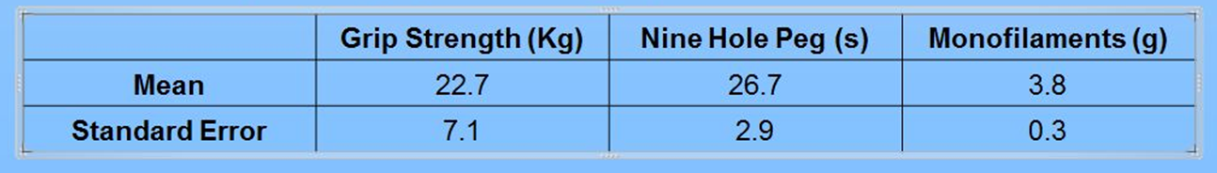
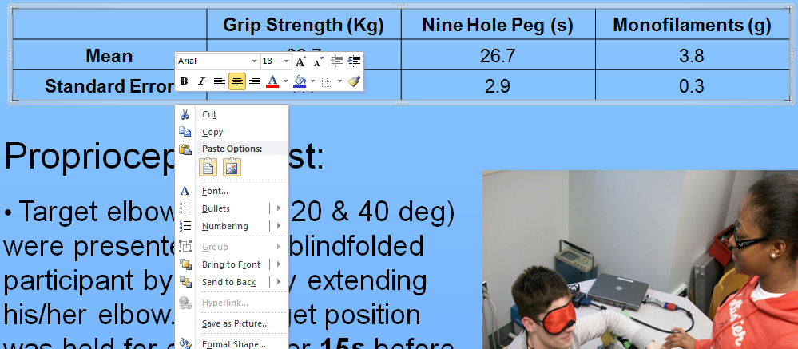
Excel graphs
One would think Excel graphs and Powerpoint posters play well together.
Maybe, maybe not! What to do if you need to convert Excel graphs into Pictures.
“Select All” and look for graphs and images that have “frames” around them >
These handles sometimes appear when you insert an Excel graph; they do not print well – chart labels often disappear.
Right-click on the “frame” and choose Save As Picture.
Save as a Ping (png) file. This works fine for most Excel graphs.
Then reinsert png image and delete Excel graph.

